Slide 1
Unit 3A
Human Form & Function
Cells, metabolism & regulation
Regulation of blood pressure

Slide 2

Study Guide
Read:
Our Human Species (3rd edtn)
Chapter 10, sections 4-12
Complete:
Human Biological Science Workbook
Topic 7 – Regulation of Blood Pressure

Slide 3
Blood pressure
blood pressure is the pressure of the circulating blood against the walls of the blood vessels.
Pressure is highest when the ventricles in the heart contract (systole) and lowest when they relax (diastole).

Slide 4
systolic and diastolic pressure
Blood pressure is recorded as two numbers: the top number is called the systolic pressure and the bottom number is called the diastolic pressure.
Adult blood pressure is considered normal at around 120/80.

Slide 5
Measuring blood pressure
Blood pressure is usually recorded from the brachial artery in the arm, just above the elbow.
Blood pressure falls as the blood moves further away from the heart.
Blood pressure in the veins (venous pressure) is much lower than the arterial blood pressure.

Slide 6
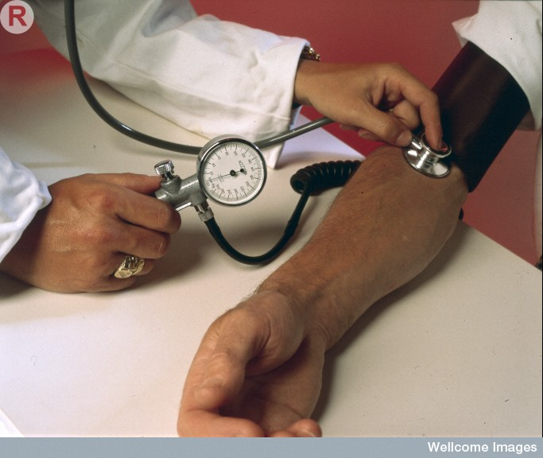
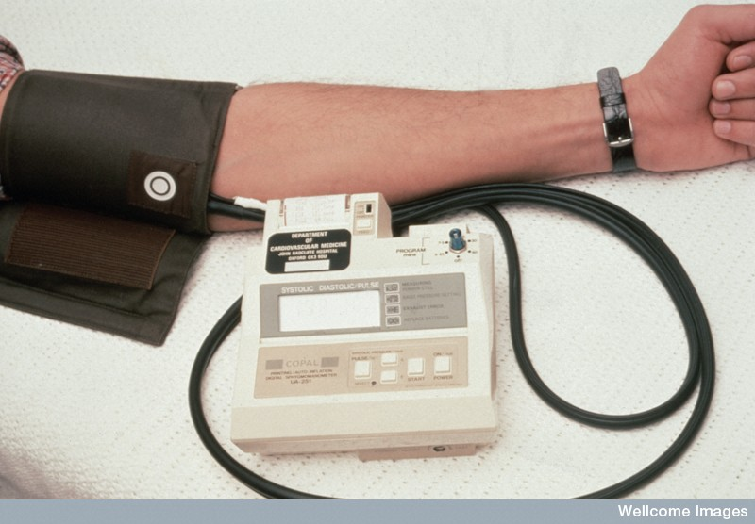
Blood pressure is measured using a sphygmomanometer.
Values are reported in millimeters of mercury (mmHg)
Kate Whitley, Wellcome Images
Wellcome Photo Library
A traditional analogue sphygmomanometer (left) and an electronic digital sphygmomanometer (right).

Slide 7
Category | systolic, mmHg | diastolic, mmHg
Hypotension | < 90 | or < 60
Normal | 90 – 119 | and 60 – 79
Prehypertension | 120 – 139 | or 80 – 89
Stage 1 Hypertension | 140 – 159 | or 90 – 99
Stage 2 Hypertension | ≥ 160 | or ≥ 100

Slide 8
Physiological factors affecting blood pressure
Factor | Effect on blood pressure
The pumping action of the heart | The greater the cardiac output, the higher the arterial pressure
The blood volume | The greater the blood volume, the higher the arterial pressure
The viscosity of the blood | The more viscous the blood, the higher the arterial pressure
The condition of the blood vessels (resistance) | The greater the resistance, the higher the arterial pressure

Slide 9
The SA node
The heart contains specialised conductive tissue which regulates the heartbeat.
The sinoatrial node (SA node or pacemaker) is a cluster of specialised cardiac cells in the wall of the right atrium which initiates the heartbeat.
The atrioventricular node (AV node) is the secondary pacemaker which regulates the beating of the ventricles.

Slide 10
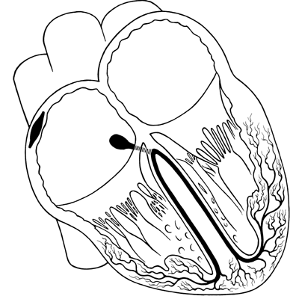
Conductive tissue
Sinoatrial (SA) node – the pacemaker
Atrioventricular (AV) node
Perkinje fibres
The Sourcebook of Medical Illustration (The Parthenon Publishing Group, P. Cull, ed., 1989)

Slide 11
Cardiac output
The cardiac output is the total amount of blood being pumped by the heart over a particular period of time – e.g. the minute volume is the amount of blood pumped by the heart over one minute
The cardiac output is affected by the stroke volume (the volume of blood pumped by each ventricle during a cardiac cycle ) and the heart rate (the number of heart beats over a particular period of time).
Cardiac output = Stroke volume x Heart rate

Slide 12
Factors that affect stroke volume
Venous return (Frank-Starling law)
Autonomic NS (sympathetic stimulation increases stroke volume)
Hormones (thyroxine, adrenaline / noradrenaline, glucagon)
Calcium & potassium levels

Slide 13
The Frank – Starling law of the heart
The greater the volume of blood entering the heart during diastole, the greater the volume of blood ejected during systolic contraction (stroke volume).

Slide 14
What does this mean?
When we exercise more blood is returned to the heart.
The more the heart muscle is stretched, the stronger the strength of the contraction (rather like a rubber band).
The stronger the contraction of the ventricle, the more blood is ejected from the heart i.e. the stroke volume is increased.

Slide 15
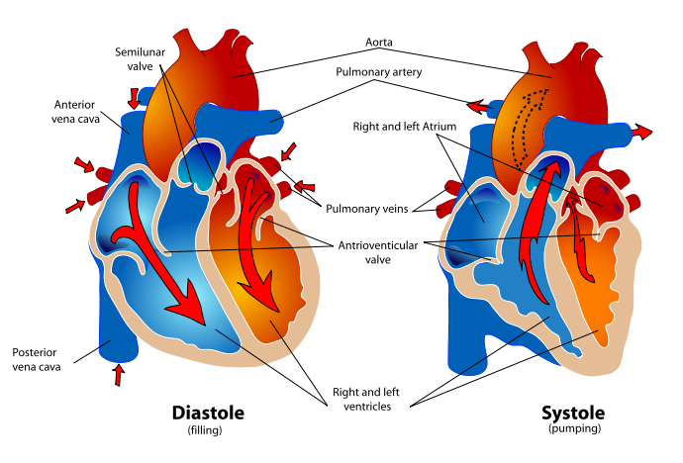
The heart in diastolic and systolic phases
Mariana Ruiz Villarreal

Slide 16
Control of heart rate
Stimulus - Change of blood pressure
Receptor - Baro (pressure) receptors in right atrium, aorta & carotid artery (sinus)
Control centre - Cardiac centre in medulla oblongata
Transmission - ANS
Effector - SA node (AV node in some cases)
Response - Sympathetic stimulation speeds up heart
Parasympathetic stimulation slows
heart down

Slide 17
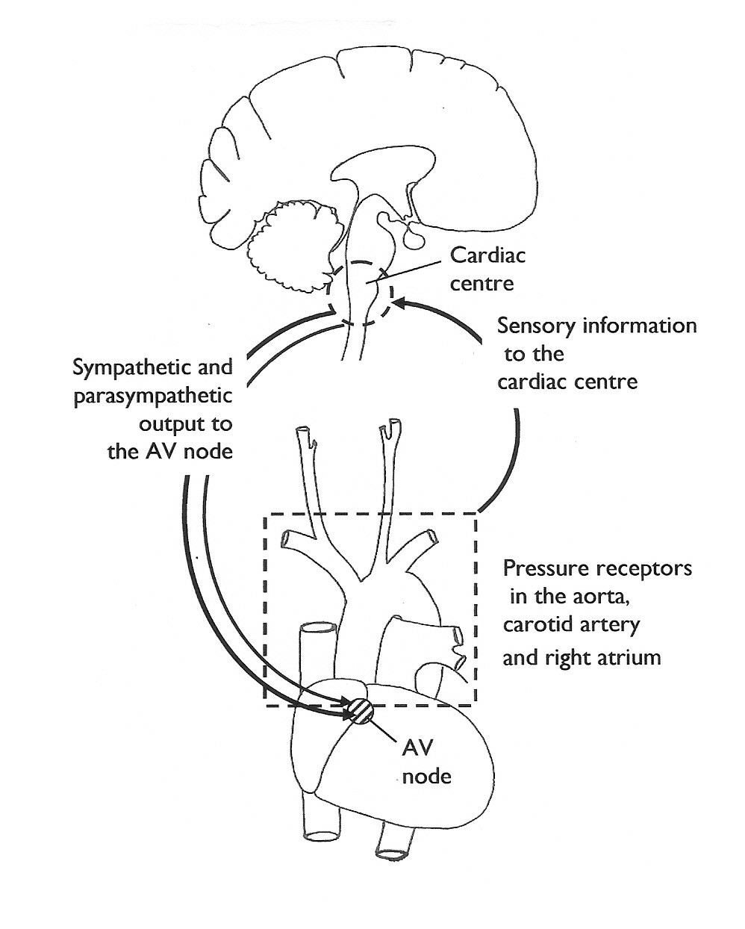
REGULATION OF THE
HEART RATE

Slide 18
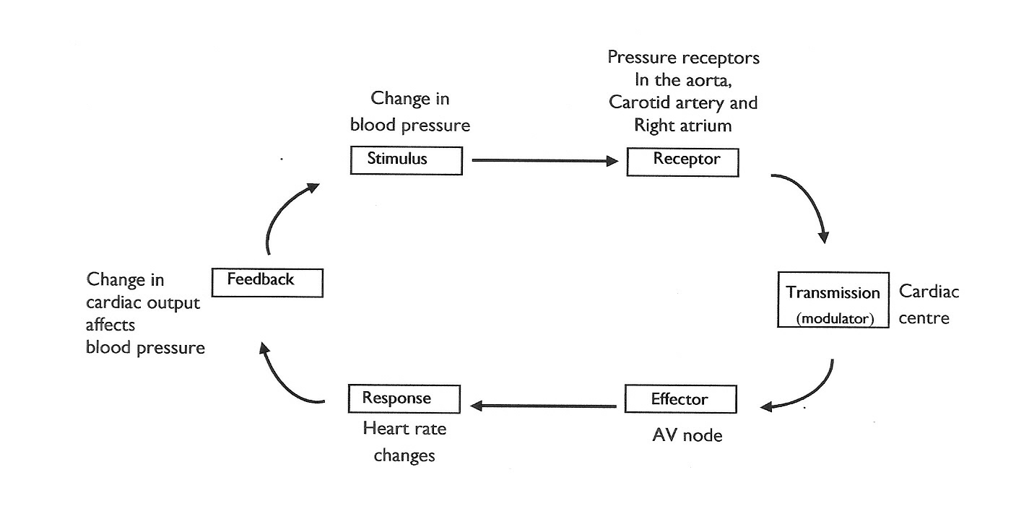
REGULATION OF THE HEART RATE

Slide 19

Other factors that influence heart rate
The heart rate can also be affected by:
  Hormones (adrenaline)
  Temperature
  Drugs
  Salts (potassium & calcium)
  Emotions (e.g. fear, anger)

Slide 20
The renin-angiotensin system
The renin-angiotensin system is a hormone system that regulates blood pressure and fluid balance.

Slide 21
Activation
A sustained fall in blood pressure is detected by pressure receptors in the kidneys (the juxtaglomerular apparatus).
The kidneys release the hormone renin.
Renin activates another hormone, angiotensin.

Slide 22
The effects of angiotensin - 1
Angiotensin (together with aldosterone and antidiuretic hormone) cause the kidneys to reabsorb salt and water and create the sensation of thirst (see Section 5).
This increases blood pressure.

Slide 23
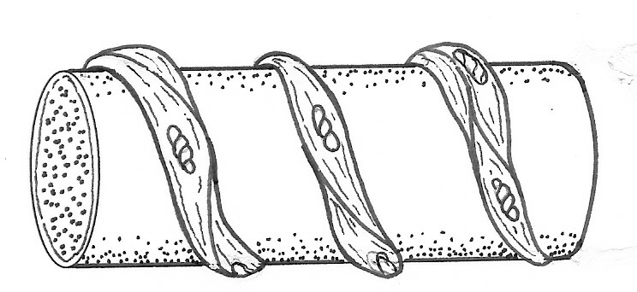
The effects of angiotensin - 2
Angiotensin causes arterioles throughout the body to constrict (vasoconstriction). This also results in an increase in blood pressure.
Arteriole
Smooth muscle
In response to sympathetic stimulation, or hormones, such as angiotensin and adrenaline, smooth muscle coiled around arterioles contracts and squeezes the blood vessels, making them smaller – this is vasoconstriction.

